Slide 1
Los Angeles City
Student’s Name
Institution

Slide 2
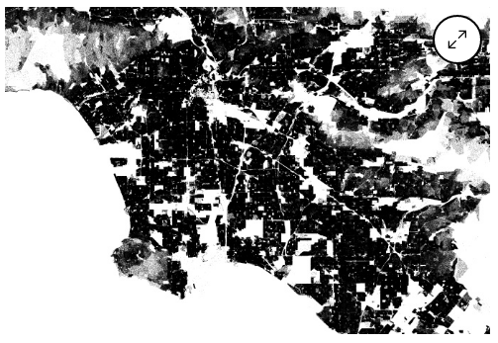
General Population Density
Notes:
Los Angeles has a smooth and perfect representation of density. The above block data shows population density in Los Angeles based on 2010 census. Unlike the other cities that has unclear and sometimes complex point of abstraction, Los Angeles City has a clean and smooth block. It is easy even to see the fading darkness of a city in Los Angeles. The map also demonstrates slightly high magnification, which makes it difficult to determine the two sides of a street.

Slide 3
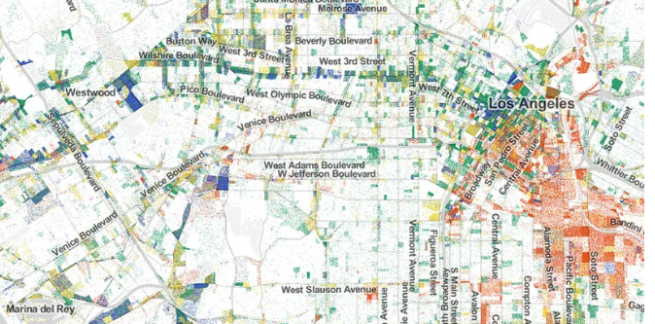
Job Distribution and Unemployment
Notes:
This slide shows job distribution in Los Angeles City. It looks different from the other cities. For example, there are a lot of jobs downtown, which is signified by the red dots on the map. The red dots symbolizes light industry and warehousing. Also, there is a thick stretch of unemployment towards westward of downtown and towards the Santa Monica. Towards the south, there are small clusters of employment. The blue dots represents the professional services, which are not concentrated on the downtown, but they are found everywhere on the map.

Slide 4
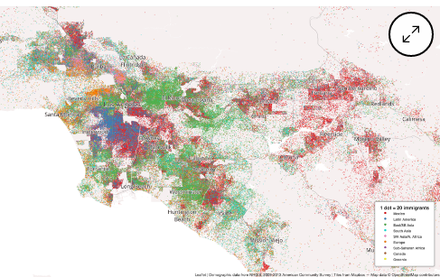
Immigrant Population
Notes:
1 dot represents 20 immigrants, with the red dot representing immigrants from Mexico, blue blue (Latin America), light green (East Asia), light blue ((South Asia), pink (North Africa), orange (Europe), purple (Sub-Saharan Africa), dark grey (Canada), and yellow (Oceania). The concentration of Los Angeles’ immigrant population shows that a good number of the city’s demographic is made up of immigrants. Immigrants from Mexico are the majority denoted by the color code red. They are followed by East/South East Asians (light green), and then Latin Americans (blue). The map further shows that immigrants are mainly concentrated on the same region, especially on the western and north western side of the city. On the east, Mexican immigrants are scarcely distributed even though they are still the majority.

Slide 5
Summary
The maps show:
Uneven job distribution in the city
The city is densely populated
Immigrant population is and continued to increase
Mexican immigrants are the majority
Notes:
The above summary shows what the three maps have depicted about Los Angeles City. Los Angeles is densely populated (general population). The job distribution also shows that jobs are unevenly distributed with the majority located towards the downtown. Also, the number if immigrant population in Los Angeles is significantly high, with the Mexican immigrants leading.

Slide 6
References
General Population. https://www.bloomberg.com/news/articles/2012-12-28/mapping-the-census-a-dot-for-every-person
Immigrant Population. https://www.bloomberg.com/news/articles/2015-09-04/a-colorful-dot-map-of-america-s-immigrants
Job Distribution. https://www.vox.com/2015/7/29/9066963/jobs-dot-map

